Slide 1
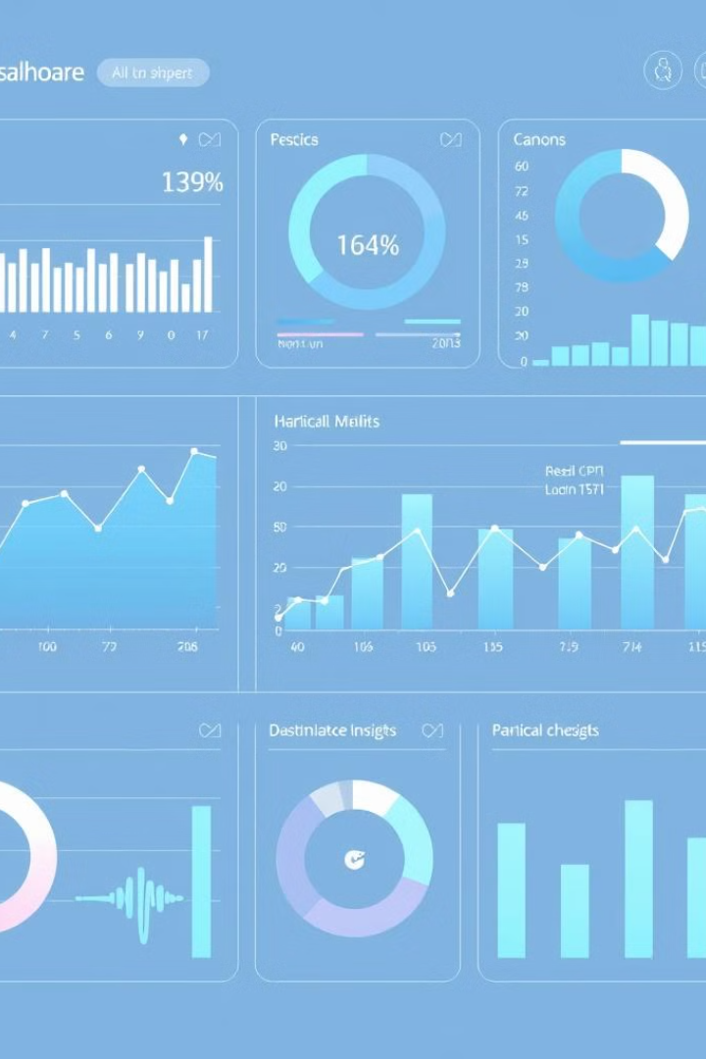

Healthcare Data Analysis and Insight
This presentation provides a comprehensive overview of a data analysis project conducted on a healthcare dataset. The project aims to extract meaningful insights related to patient health, medical histories, and healthcare costs. By leveraging data analysis techniques, we seek to improve patient care, allocate healthcare resources effectively, and provide actionable insights for stakeholders in the healthcare industry.
by Navina Jolene

Slide 2

Problem Statement
The healthcare industry is a prolific generator of data. This project addresses the challenge of transforming raw, unstructured healthcare data into actionable intelligence. By analyzing a comprehensive dataset including medical examinations, hospitalization details, and customer profiles, we aim to uncover insights into patient health profiles, medical histories, and healthcare costs that can drive better decision-making and improve healthcare outcomes.
Data Overload
Vast amounts of data are generated daily.
Insight Extraction
Extracting insights on patient health, medical histories, and healthcare costs.

Slide 3

Project Objectives
The primary objective of this project is to leverage data-driven insights to improve patient care within the healthcare system. Efficient resource allocation is another critical objective, ensuring that financial and personnel resources are strategically deployed where they are most needed. Furthermore, the project aims to identify significant trends in medical histories and healthcare costs, enabling proactive decision-making and strategic planning.
Improve Patient Care
Effective Resource Allocation
Trend Analysis

Slide 4




Data Cleaning
The initial stage of this project involved rigorous data cleaning to ensure the integrity and reliability of the analysis. Missing values in medical and hospitalization data were carefully checked and handled, with missing 'month' values filled with 'Sep'. Estimations were made for missing 'year' values, and missing 'smoker', 'Hospital Tier', and 'City Tier' entries were imputed with the most frequent values. Additionally, missing 'State ID' values were replaced with 'Unknown'.
Handle Missing Values
Impute Missing Data
Correct Inconsistencies

Slide 5
Data Transformation
Once the data was cleaned, it underwent several transformations to make it suitable for analysis. 'Customer Names' were split into Title, First Name, and Last Name components to facilitate more granular analysis. The 'NumberOfMajorSurgeries' column was converted to a numerical format, and inconsistencies in 'Heart Issues' and 'Smoker' columns were identified and corrected. Moreover, BMI values were categorized into 'Underweight', 'Normal', 'Overweight', and 'Obesity', while HbA1C levels were classified into 'Normal', 'Prediabetes', and 'Diabetes'.
Split Customer Names
Categorize BMI and HbA1C
Improve data organization
Enable trend analysis

Slide 6




Data Exploration
Exploratory data analysis was conducted to understand the key characteristics and patterns within the dataset. This involved identifying the existence of duplicate Customer IDs and determining the number of customers with a history of cancer. The percentage of customers who had undergone transplants was calculated, and the total number of major surgeries performed was aggregated. Additionally, the average HbA1C value of smokers was determined to assess the impact of smoking on diabetes risk.
Duplicate IDs
Cancer History
Transplant Patients

Slide 7



Pivot Table Analysis
Pivot table analysis was employed to summarize and analyze data across different dimensions. The total number of major surgeries for transplant patients was compared against that of non-transplant patients to assess the impact of transplants on surgical history. Additionally, the average HbA1C for transplant patients was compared against that of non-transplant patients to understand the relationship between transplants and diabetes risk. Furthermore, total charges were compared across different hospital tiers to evaluate cost disparities within the healthcare system.
1
Surgery Comparison
2
HbA1C Comparison
3
Charge Comparison

Slide 10

Visual Analysis Using Charts
Visual analysis played a crucial role in identifying and communicating key insights. A pie or donut chart was used to illustrate the distribution of cancer history among smokers and non-smokers, while a column or bar chart was used to compare healthcare charges based on weight and diabetes status. A line or scatter plot was employed to explore the correlation between age, BMI, HbA1C, and healthcare charges, providing a visual representation of the relationships between these variables.
Chart Type
Purpose
Pie/Donut
Distribution of cancer history
Column/Bar
Healthcare charges by weight and diabetes status

Slide 11




Key Insights & Conclusion
The analysis revealed several key insights, including a positive correlation between higher BMI and age with increased healthcare costs. Smokers exhibited higher average HbA1C values, and patients with multiple surgeries tended to have higher hospitalization charges. Healthcare costs varied significantly across different hospital tiers and states. These data-driven insights have the potential to improve decision-making for healthcare providers, leading to more effective resource allocation and improved patient outcomes.
Cost Drivers
HbA1C Impact
Hospital Disparities

